Slide 1

Online
Food
Ordering
Submitted by:
Puneet Kumar
11501095
3CE3
3rd year 5th sem

Slide 2
Main features Of Java
Simple
Pure Object Oriented
Platform Independent
Machine Independent
Robust and Secure
Strictly Typed Language
Totally Dynamic

Slide 3
GUI
Graphical interaction with user.
No need to remember commands.
Components of GUI :
Command button
Radio button
Textbox
Label

Slide 4
Introduction to Online food Ordering
Online Food Ordering helps the customers to fulfill their product requirement in an efficient and effective way by providing them with the best facility to purchase Food online.
There are basically three Module:
Admin Module
Restaurant Module
Customer Module

Slide 5
Types of Users
User
Customer
Admin
Restaurant
Guest
Buyer
Guest
Seller

Slide 6
MODULAR DESCRIPTION OF PROJECT- Online Food Ordering
Admin Module
View User
Active/Inactive User
View Restaurant
Active/Inactive User
Delete User
Delete Restaurant
Add Admin
Remove Admin
Add blog
View & Edit Notice
View Queries & Complaints

Slide 7
MODULAR DESCRIPTION OF PROJECT-Online Food Ordering
User Module
Change Profile
View Profile
View Restaurant
Search Restaurant
View menu
Give Feedback
Add Blog
Edit/delete Blog
View Cart
Order Food

Slide 8
MODULAR DESCRIPTION OF PROJECT-Online Food Ordering
Restaurant Module
Add Menu
Modify Menu
View Feedback
Pending Orders
Search menu

Slide 9
ADVANTAGES
Saves time and energy
Products easy to find
Wider range of options
Privacy
User friendly
Portability
Adequate Security of Data

Slide 10
Features
It is secure
Instant Information
Administrator is the master user who controls all the users on the site.
User can also check his list of items before confirming the order in the cart.
Allows far away customers to place the orders for the Items in quick time.
Provides the facility to know the availability of items.

Slide 11
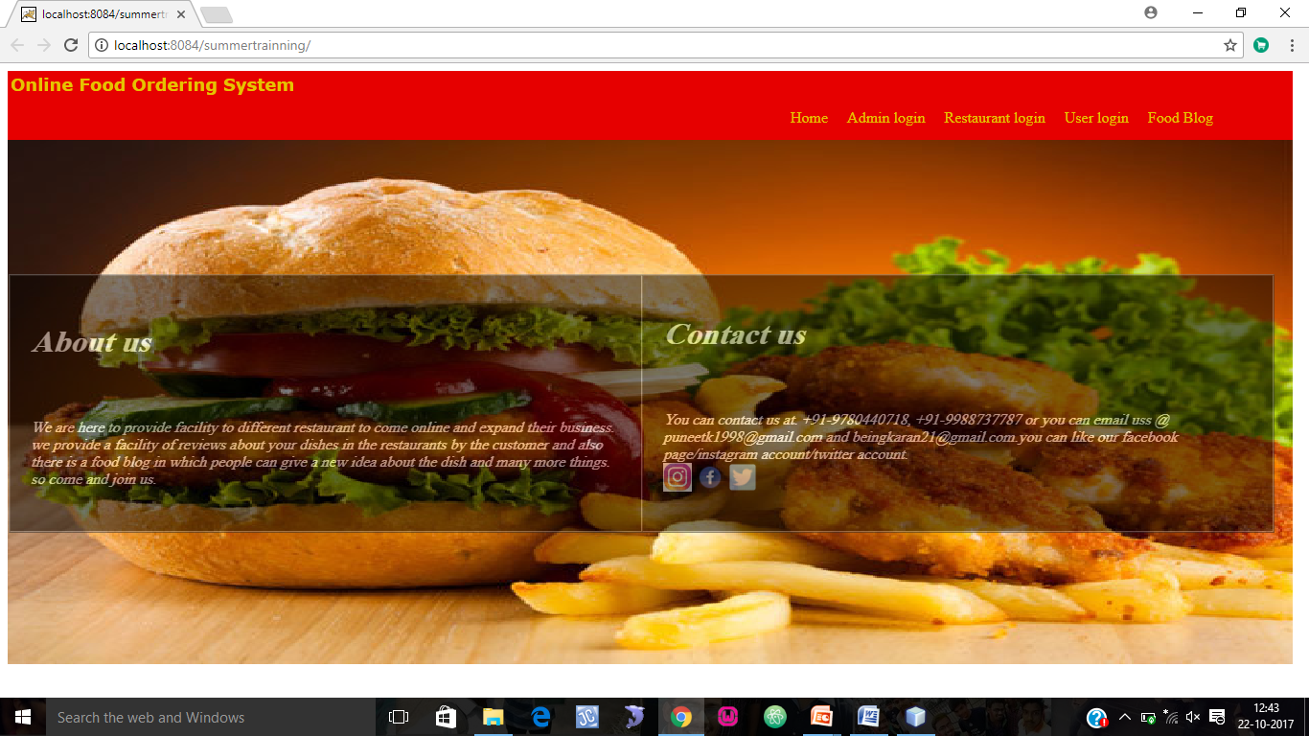
Screenshot: Front Page

Slide 12
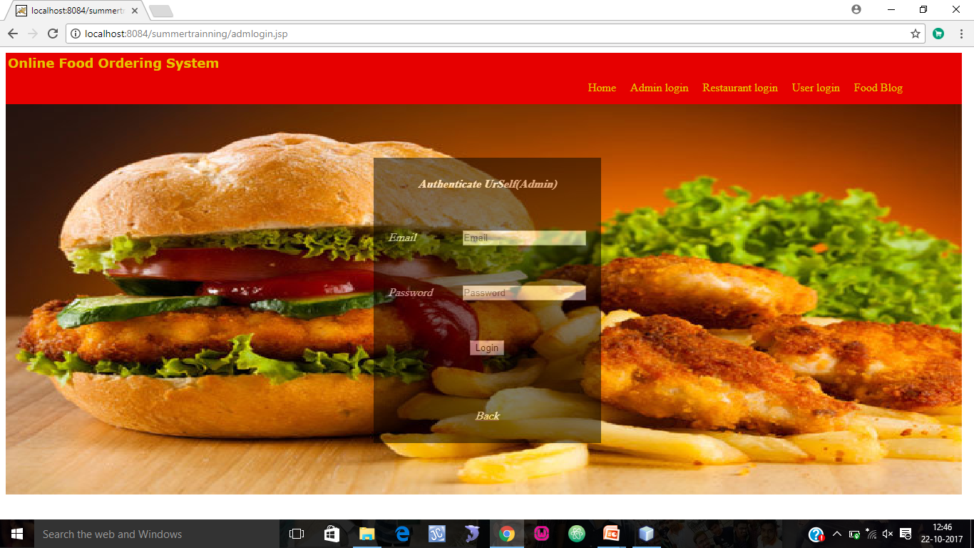
ADMIN LOGIN

Slide 13
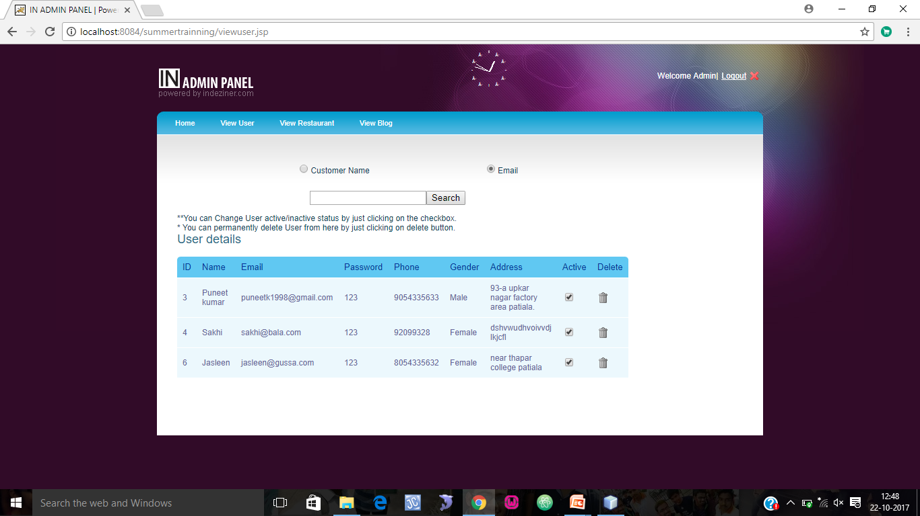
ADMIN:VIEW/MODIFY USER

Slide 14
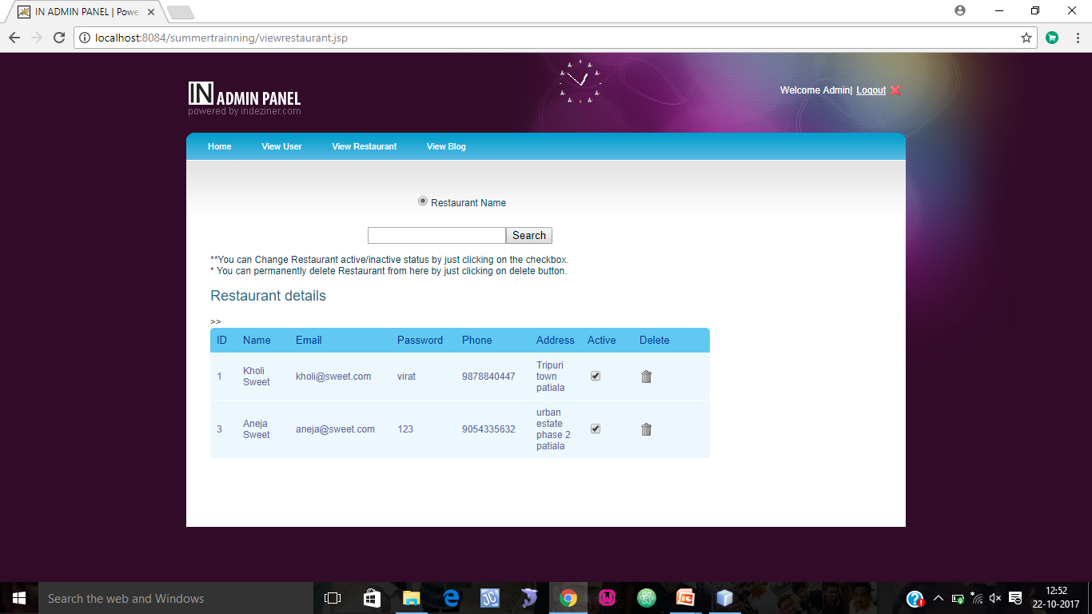
ADMIN:VIEW /MODIFY RESTAURANT

Slide 15
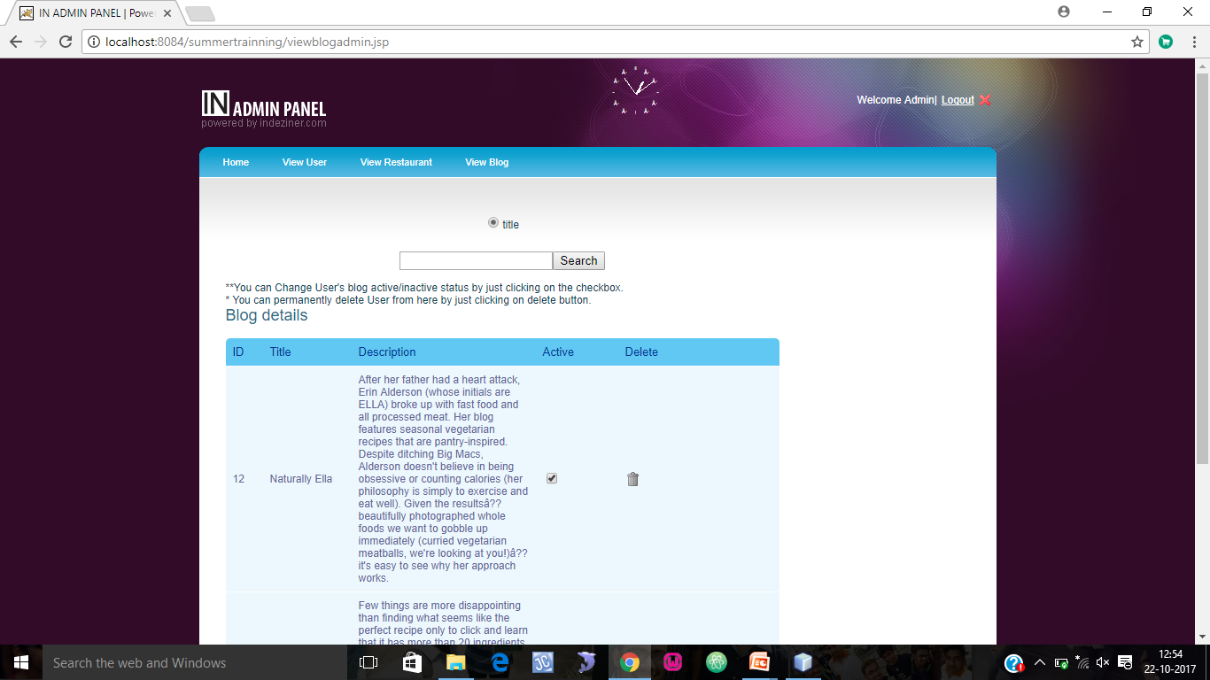
ADMIN:VIEW /MODIFY BLOG

Slide 16
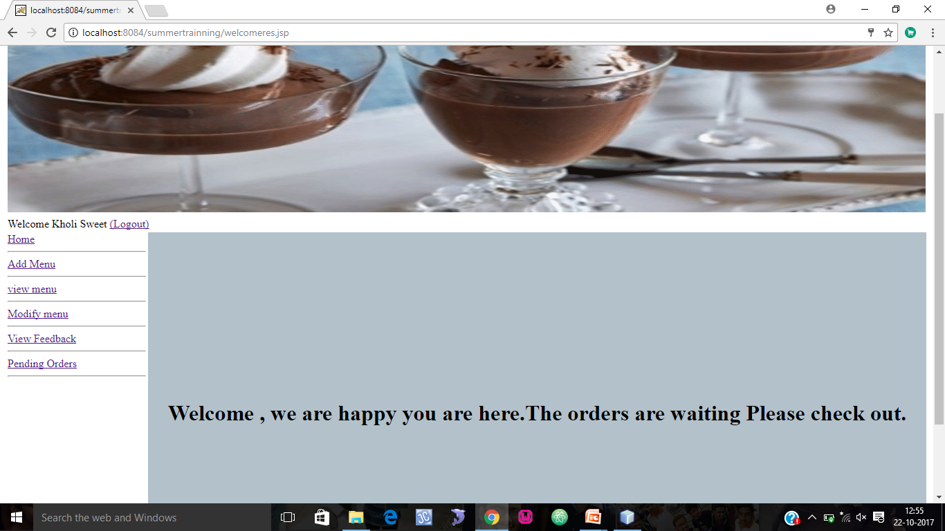
RESTAURANT:WELCOME

Slide 17
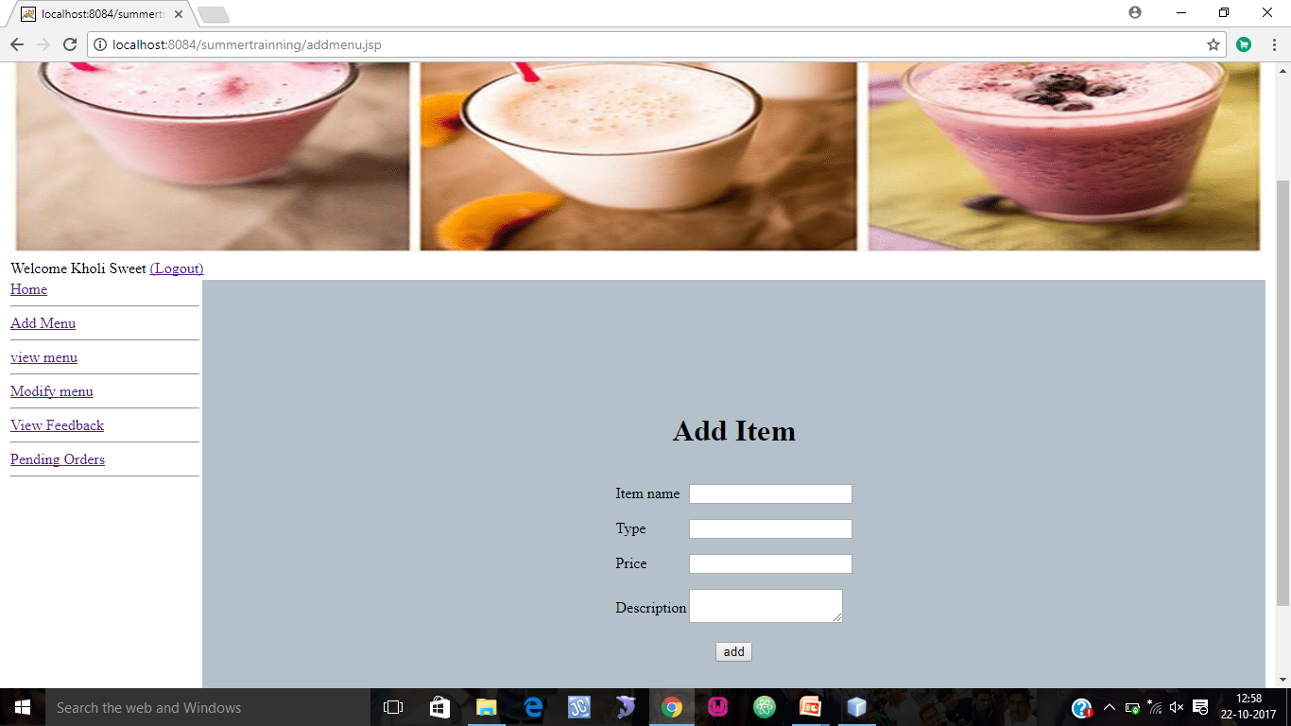
RESTAURANT:ADD MENU

Slide 18
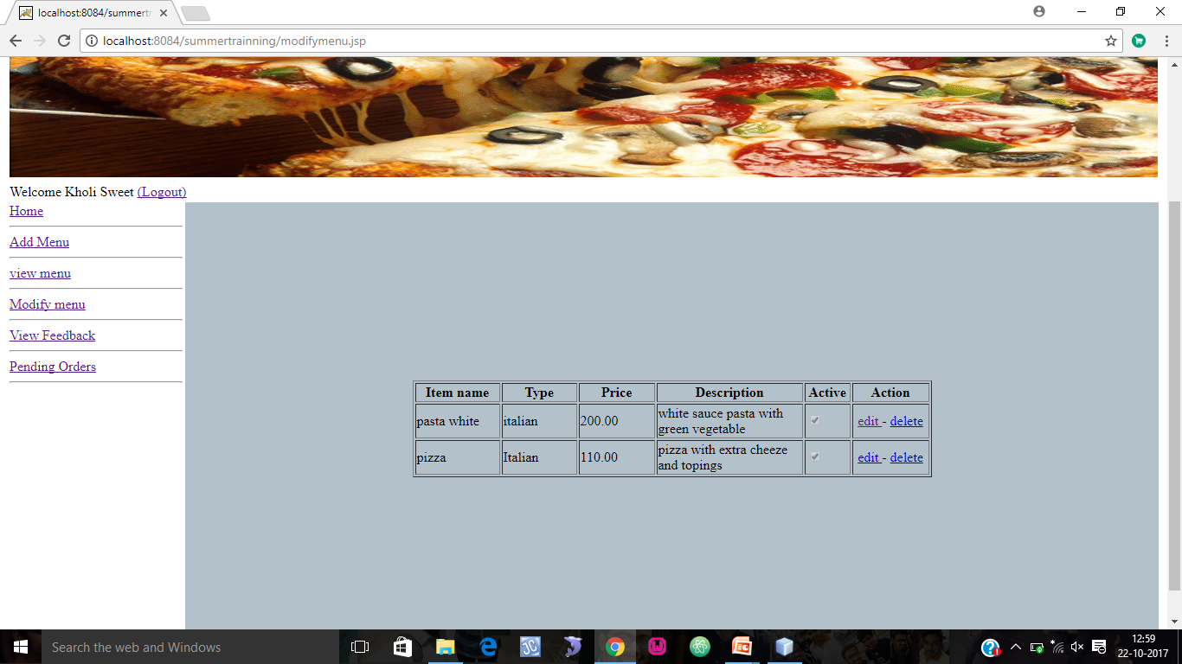
RESTAURANT:MODIFY MENU

Slide 19
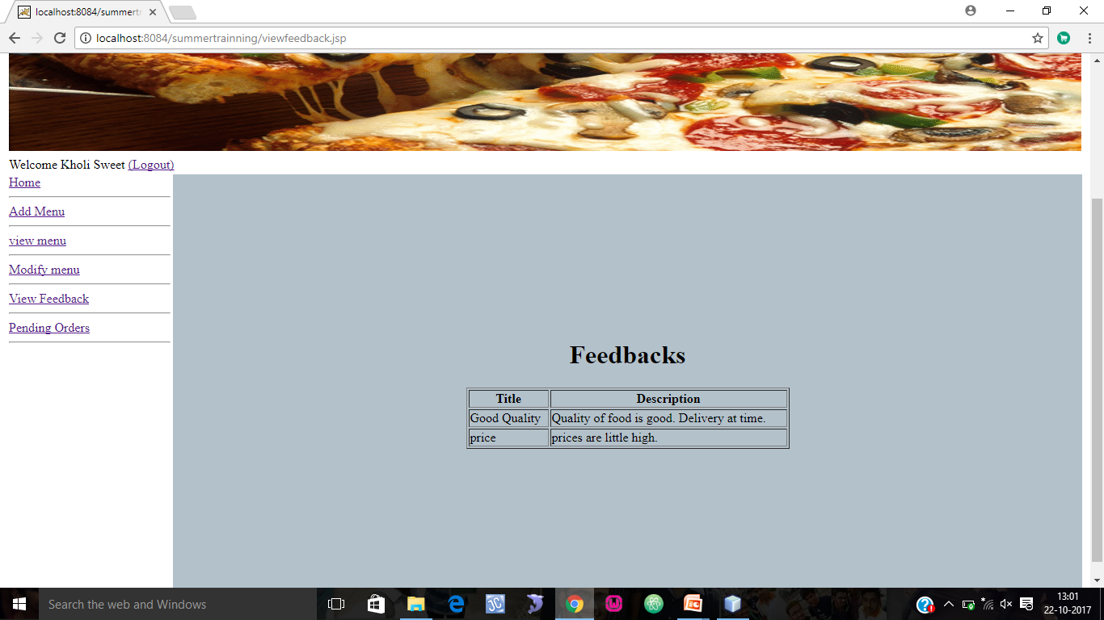
RESTAURANT:VIEW FEEDBACK

Slide 20
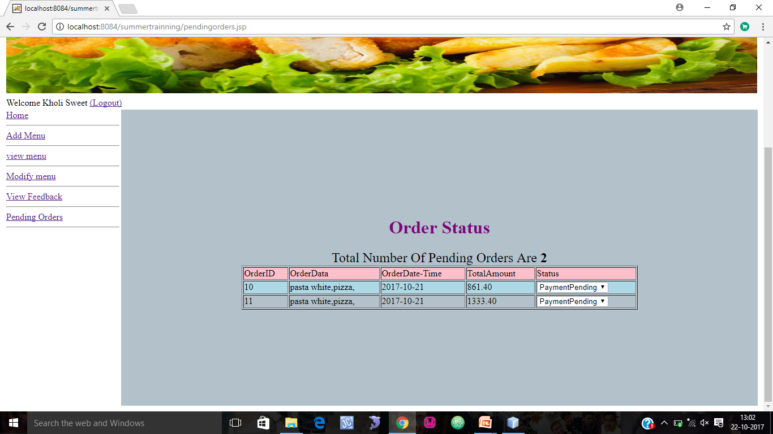
RESTAURANT:VIEW PENDING ORDERS

Slide 21
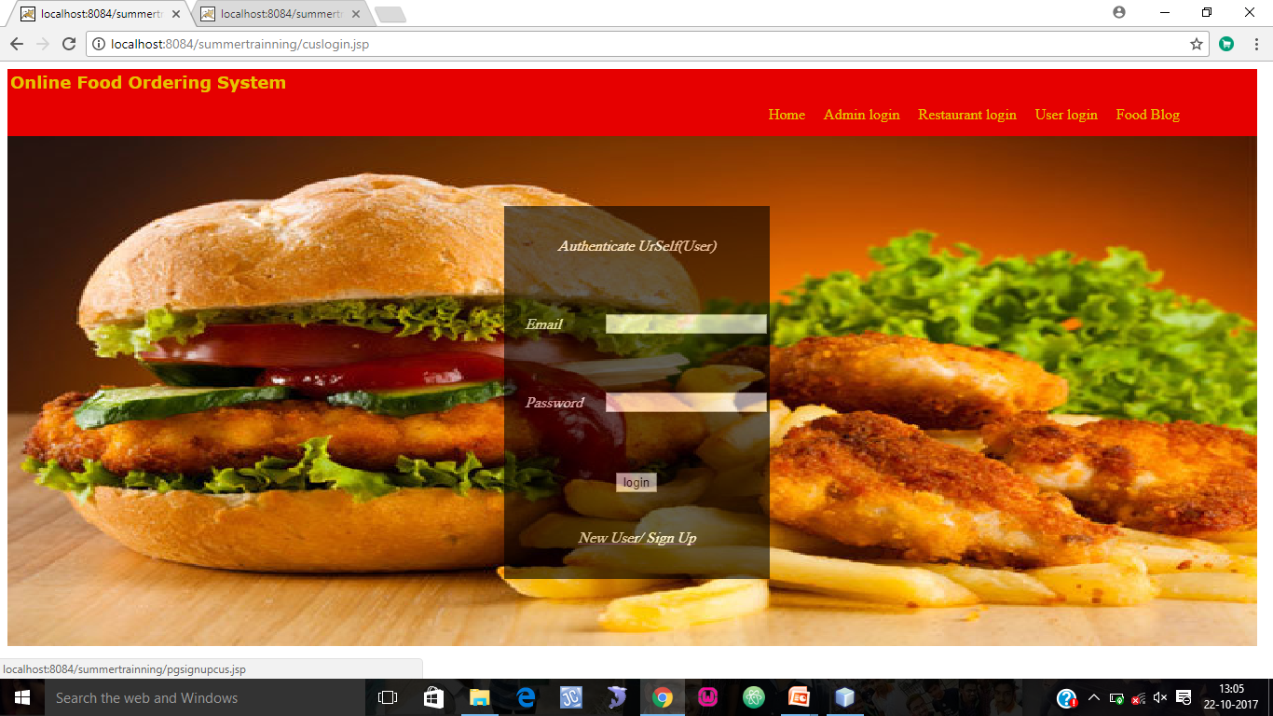
USER:LOGIN

Slide 22
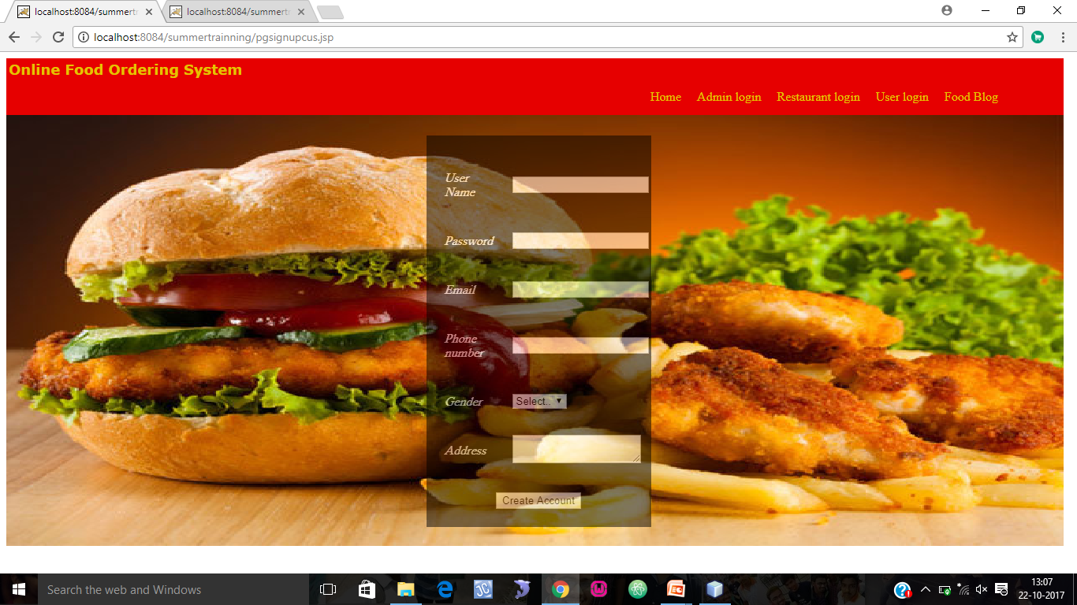
USER :NEW USER

Slide 23
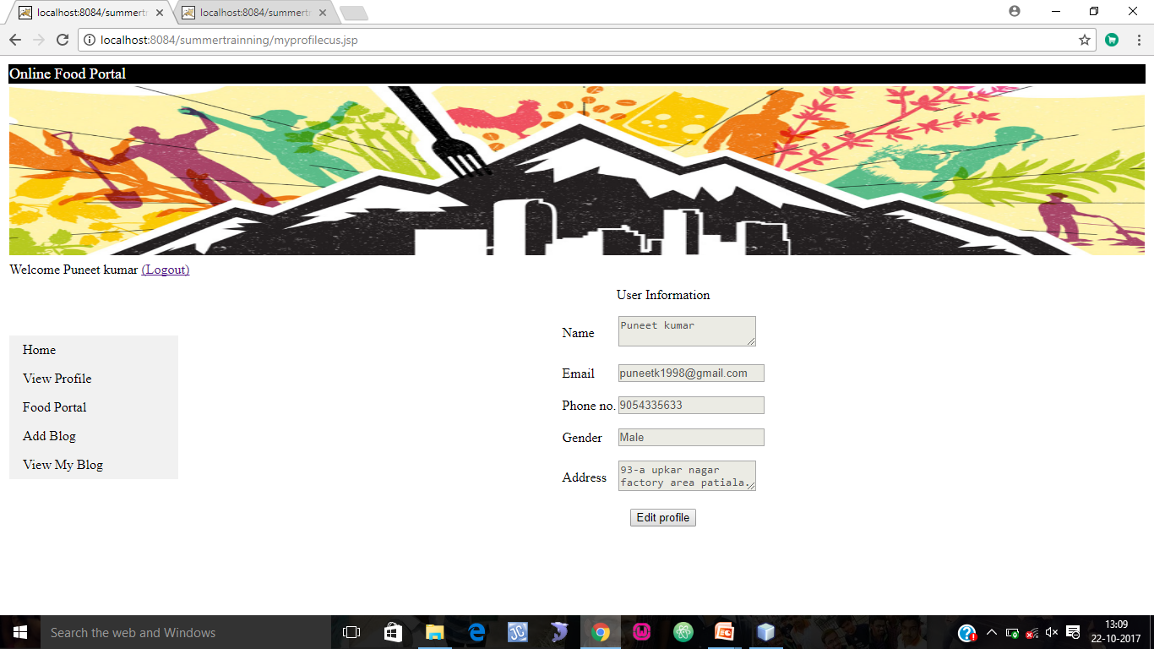
VIEW/CHANGE PROFILE

Slide 24
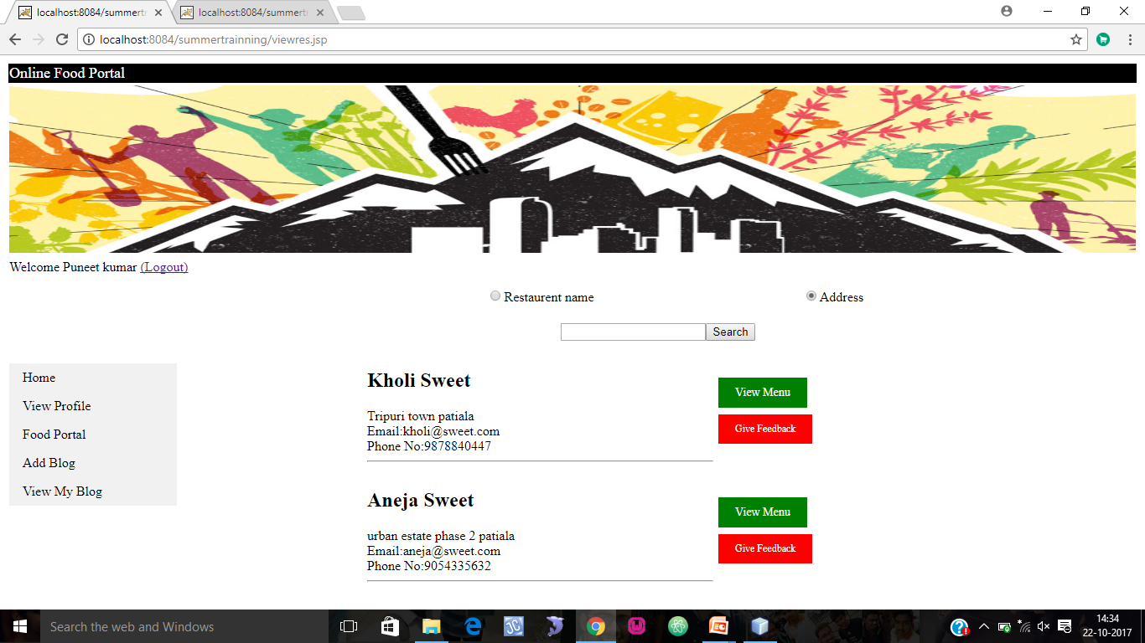
VIEW RESTAURANT/MAKE ORDER/GIVE FEEDBACK

Slide 25
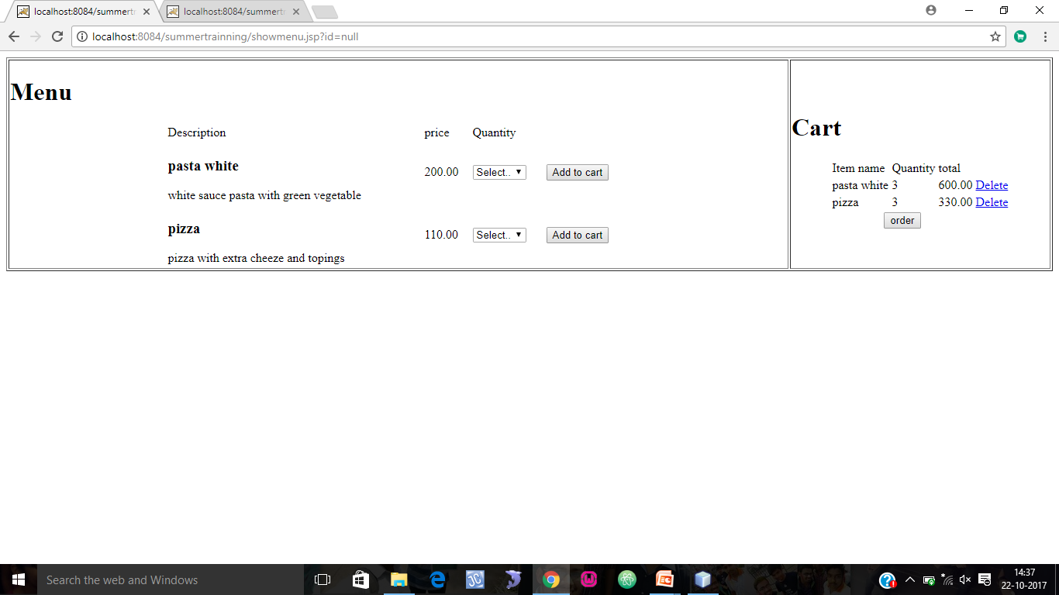
ORDER/CART/PLACE ORDER

Slide 26
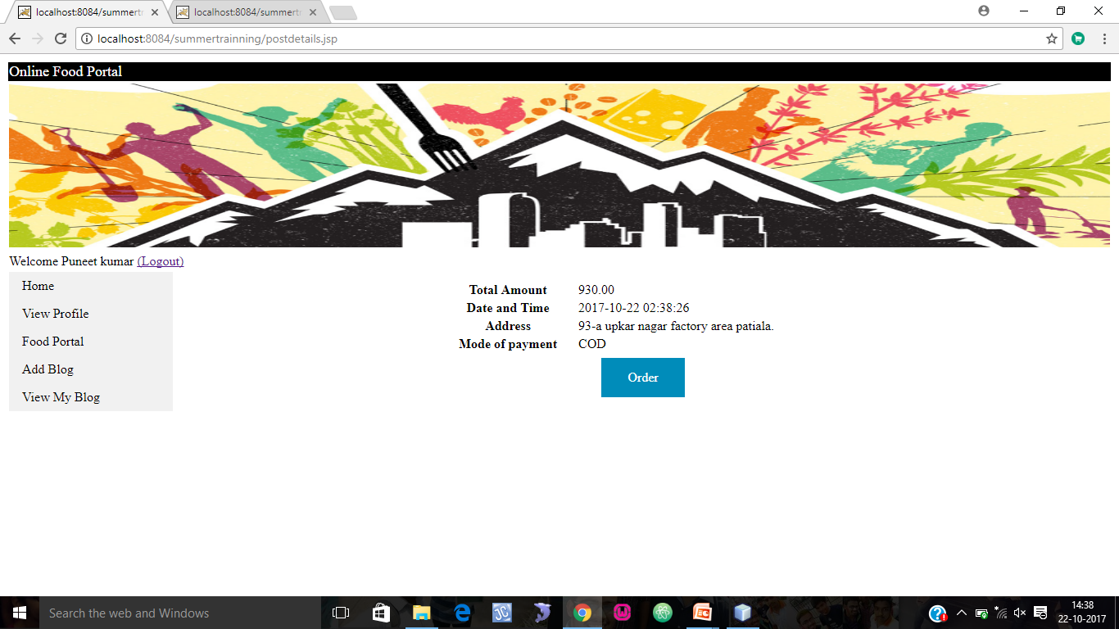
ORDER DETAILS

Slide 27
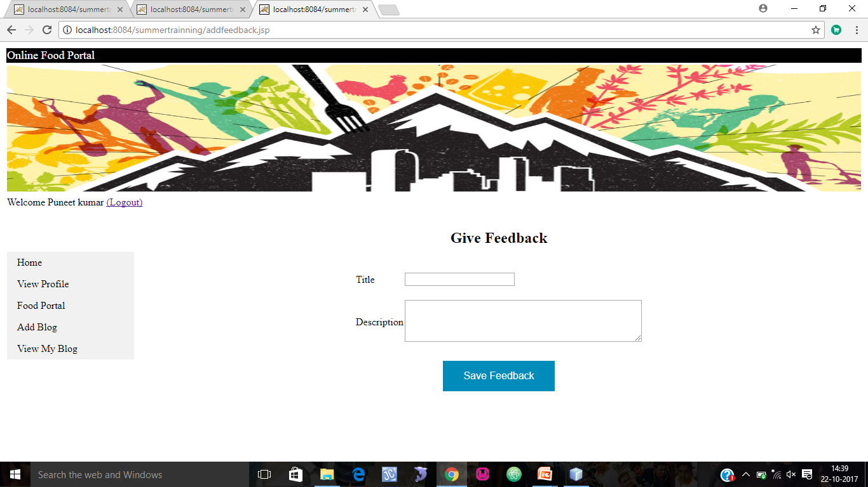
GIVE FEEDBACK

Slide 28
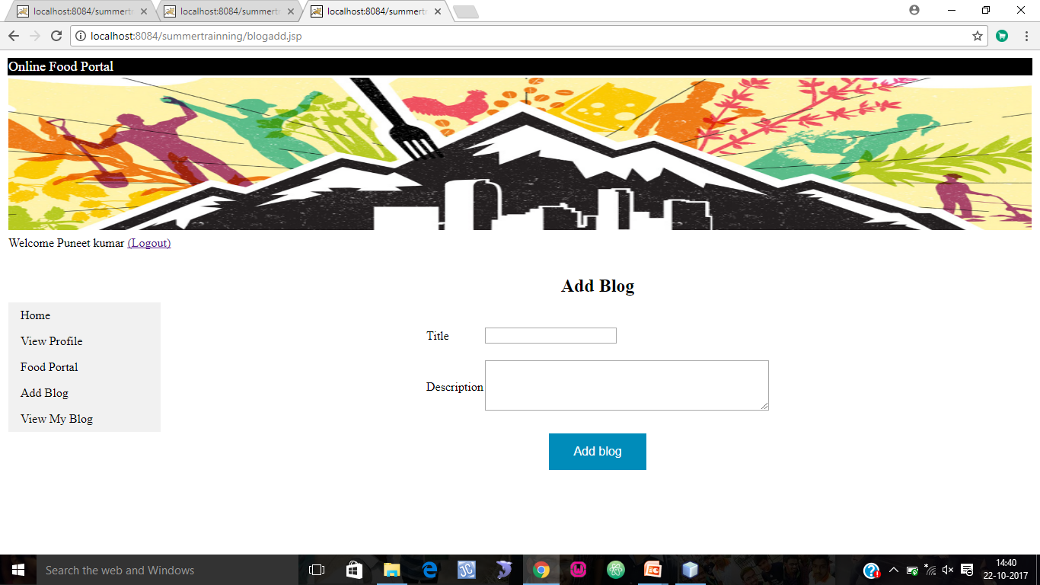
Add Blog

Slide 29
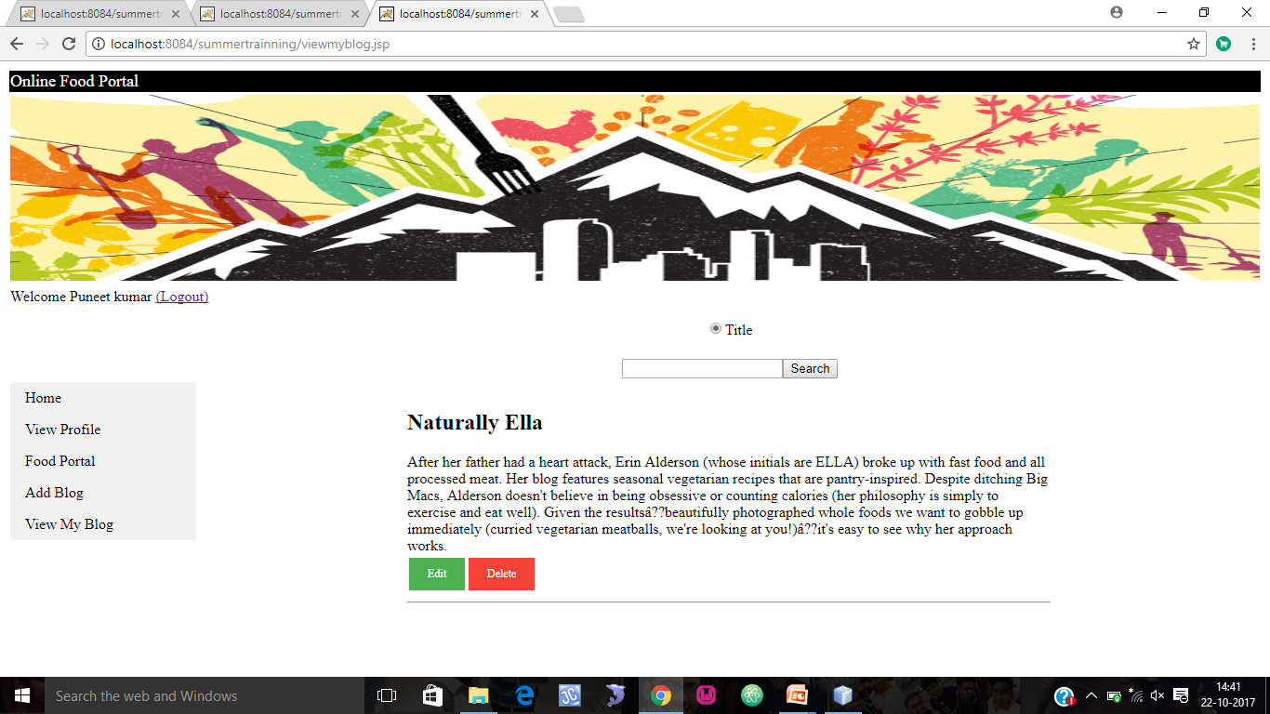
VIEW/EDIT/DELETE BLOG

Slide 30
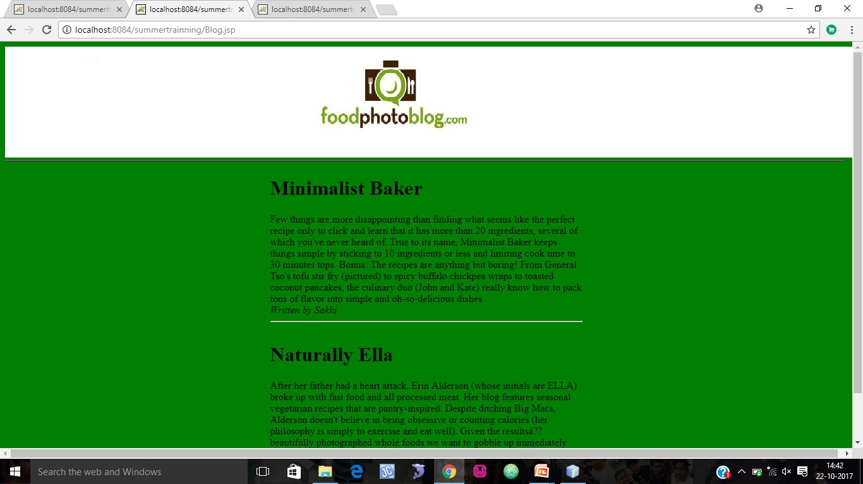
BLOG FOR GUEST

Slide 31
Security Issues
Main Issue or Threat to Security is –
SQL Injection
Ways to Tackle this
Back Button Disable
Brushing: Setting Max Length for each Field
If email is null on any page user can’t login

Slide 32
Hardware requirements
Deployment Server
PC: WAMP Server
Processor: Intel Pentium Processor 5, 2.4GHz or above.
RAM: 512 MB RAM
HDD: 40 GB
End User’s PC
Processor: Intel Pentium Processor 5, 233 MHz or equivalent
RAM: 512 Mb RAM, Windows
HDD: 500 MB of free HDD space for Internet Cache
Internet Connection: 512 K

Slide 33
Software requirements
Deployment Server
Operating System: Windows
Other software: MySQL Server
Web Server: Apache Tomcat or GlassFish Server
Language compiler: jdk1.5 or above
End User’s
Operating System: Win 2000 / Win XP or higher Windows
Browser: IE 9, Firefox 12
Active X/ Plug-in: None

Slide 34
References
BOOK REFERENCES:
The Complete Reference Java2 by Herbert Schildt
Simplified Approach to DBMS by Prateek Bhatia & Gurvinder Singh
Oracle Database PL/SQL Language Reference, 11g Release 1 (11.1) by Ivan Barslow
WEB REFERENCES:
URL: http://www.mvayoo.com/
URL: http://www.w3schools.com/
URL: http://www.stackoverflow.com/

Slide 35
THANK YOU

